Slide 1
Tone and Vocab
Warm Up

Slide 2
DIRECTIONS  Select the correct answer  Highlight words/phases in the passage that help support your answer

Slide 3
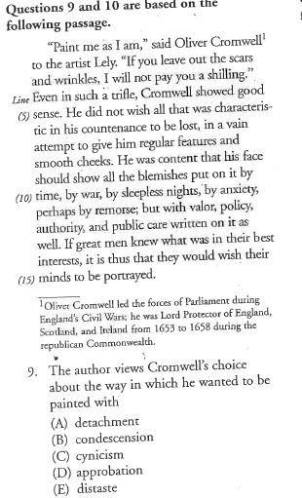

Slide 4
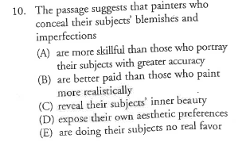

Slide 5
